Slide 1
Breast Cancer and Recurrence Classification
Harish Rithish, Jeff Makings

Slide 2
Background/Dataset
SILVER-Seq performed on approximately 5 ul of patient serum
Given raw read counts and TPM from exRNA from each patient
Patient type –> Dataset | Normal Samples | Cancer (non-recurrent) | Cancer (recurrent)
PNAS Dataset (Training) | 32 | 68 | 28
“Validation” Dataset (Testing) | 78 | 75 | 8

Slide 3
Cancer Classifier: Feature Selection with ANOVA F
Higher F value = More variation due to this gene
Use the genes with top n highest F values as features
Mean Square Between Groups
Mean Square Within Groups
Variation due to group differences
Variation from individual sample differences
F Value =
=

Slide 4
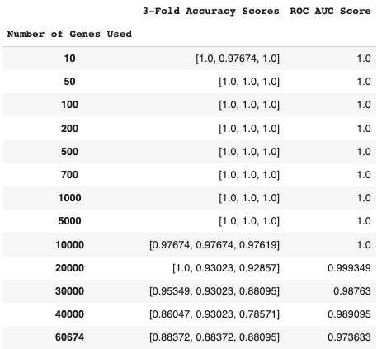
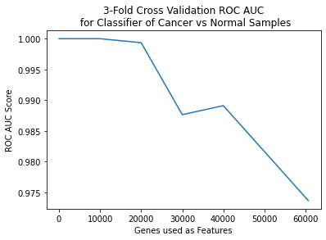
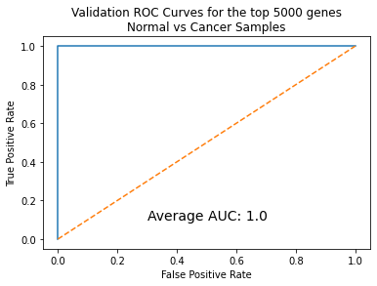
Cancer Classifier: Model Selection
Used Random Forest with 100 decision trees
Gene transcripts per million (TPM) used as opposed to raw counts:
But how many genes should be used?
d
Top 5000 genes selected due to 100% Accuracy
on 3-Fold Validation and AUC of 1.0

Slide 5
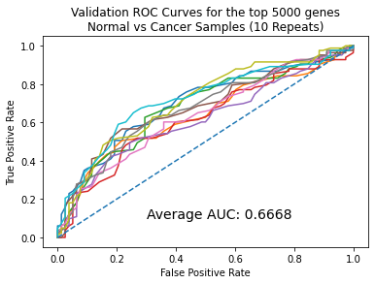
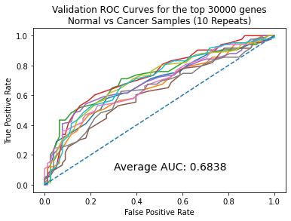
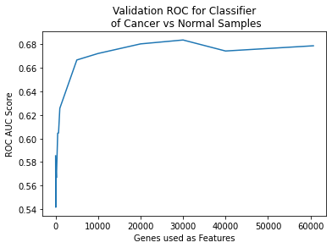
Cancer Classifier: Results
The chosen classifier trained on the top 5000 genes was tested on validation set
Average AUC: 0.6668
Balanced Accuracy Rate: 0.5648
However, the classifier using 30000 genes achieved best AUC with similar BAR
Average AUC: 0.6838
Balanced Accuracy Rate: 0.5592
Takeaway: For cancer vs normal classifier, more genes (generally) nets greater classification accuracy

Slide 6
Two Approaches to Recurrence Classification
Approach 1: Refit Normal vs Cancer Classifier
Select various n TPM features with highest F-value
Perform 3-fold cross-validation on Random Forests fit to these features
Select “best” model and test on the validation dataset
Approach 2: Longitudinal change with Time-course data
Longitudinal gene expression changes after chemotherapy used to differentiate recurrent and non-recurrent cancer individuals

Slide 7
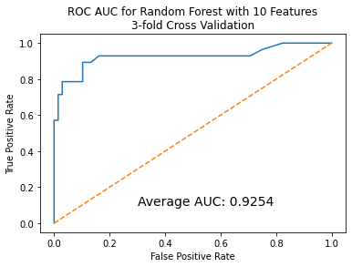
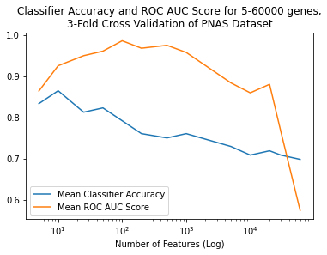
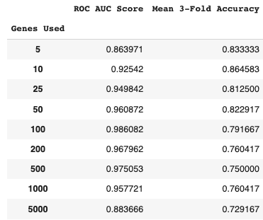
Recurrence vs Non-recurrence: Feature Selection
Using the same methods (n best F-value genes, n = 100 Random Forest model) we trained a model for recurrence classification
Highest 3-fold cross-validation ROC AUC scores were achieved using 50-1000 genes
However, chose to test using just 10 genes because it achieved 86% accuracy while still maintaining ROC AUC above 0.90.

Slide 8
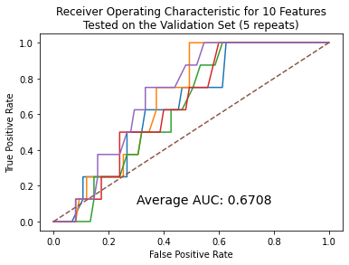
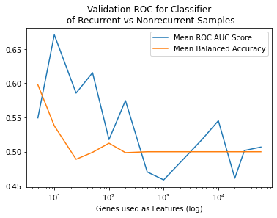
Recurrence vs Non-recurrence: Results
Using a Random Forest classifier with only the top 10 genes (by F-value)
Average AUC: 0.6708
Balanced Acc: 0.5378
Even more surprising, a classifier using just 5 genes achieved:
Average AUC: 0.5495
Balanced Acc: 0.5978

Slide 9
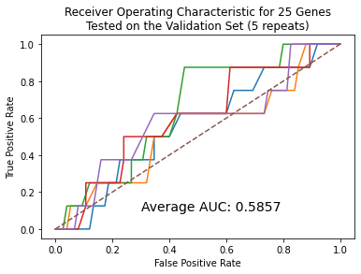
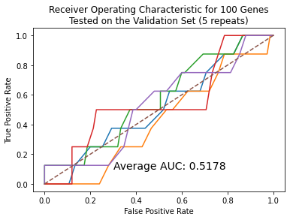
Recurrence vs Non-recurrence: Results
Beyond 10 genes, both ROC AUC score and balanced accuracy decrease
Beyond 50 genes, classifiers become trivial (predicting non-recurrent every time)
Takeaway: For the recurrence classifier, it is necessary to select a few specific genes, as too many features leads to trivial classification

Slide 10
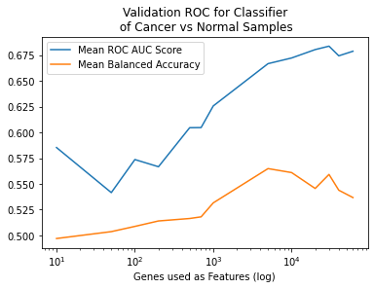
Observation on two different classification tasks..
Normal vs Cancer: BAR, AUC scales with number of features
Recurrence: BAR, AUC peak at 5,10 features respectively

Slide 11
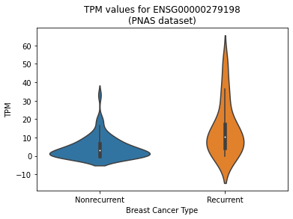
Which genes are most predictive of recurrence?
Highest F-value transcript (surprisingly) was ENSG00000279198:
An unnamed transcript on Chromosome 19, biotype unconfirmed
This transcript upregulated over 100% in recurrent breast cancer patients in PNAS set
Nonrecurrent mean: 7.83 TPM
Recurrent mean: 16.92 TPM

Slide 12
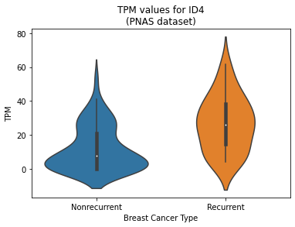
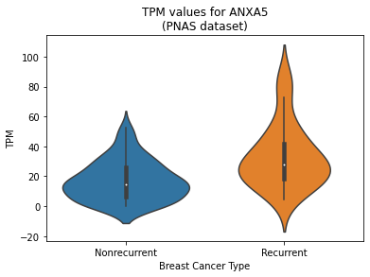
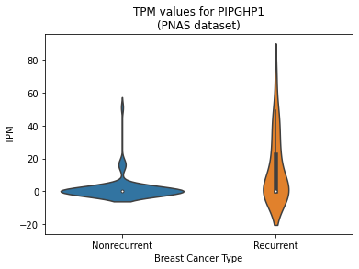
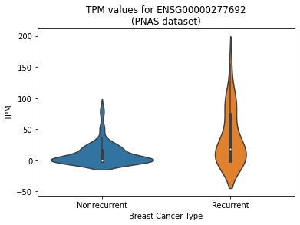
High F-value genes/transcripts from PNAS
ID4: protein coding gene for DNA-binding protein inhibitor ID4, known oncogene
ANXA5: protein coding for Annexin A5, reported to suppress or proliferate tumors depending on cancer
PIGHP1: pseudogene, phosphatidylinostitol glycan anchor biosynthesis class H
ENSG00000277692: novel lncRNA transcript, little information on this transcript
All 4 of these transcripts had greater expression AND variance in recurrent patients
Others: KCTD12, AMPD2, SKAP2, UBE2FP3, ENSG00000269931 (lncRNA)

Slide 13
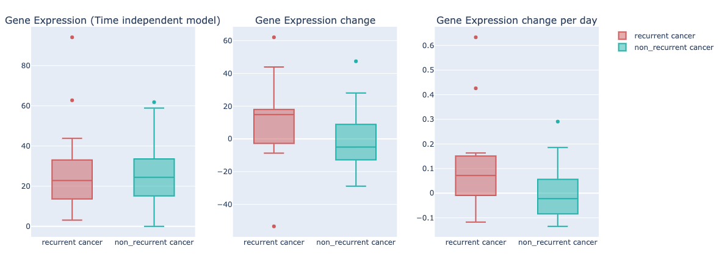
Time-course model (recurrent vs non-recurrent cancer)
Longitudinal change of gene EIF3E

Slide 14



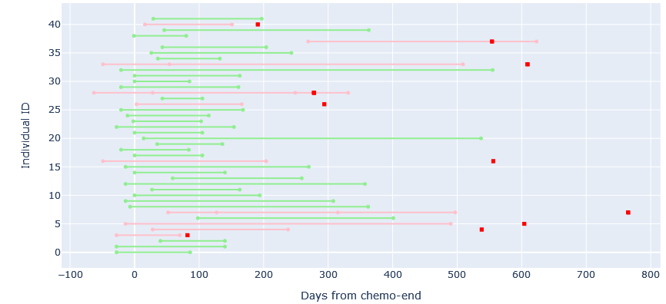
Specimens aligned with Chemo-end date
Recurrent cancer specimen
Non-recurrent cancer specimen
Day of recurrence identification

Slide 15
Dataset generation
42 individuals - 10 with recurrent cancer and 32 with non-recurrent cancer
Handling data sparsity: specimens having ‘zero’ expression level for gene-X were replaced with the mean expression level of gene-X
Filtering out less-prevalent genes: only genes with at-least 8 recurrent and 8 non-recurrent samples each were retained
42 individuals and 16000 genes!

Slide 16
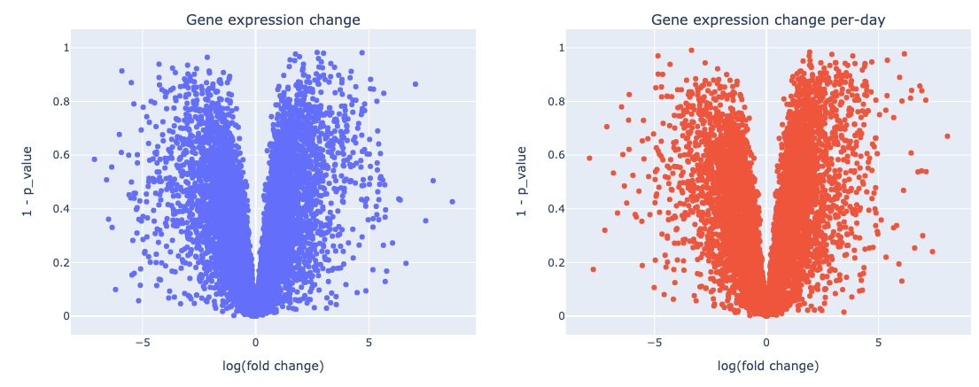
Selection of top-genes
T-test statistic used to compute p-value for each gene, by comparing recurrent and non-recurrent cancer gene-expression levels
Genes with mean fold greater than 2 and p-value less than 0.05 were selected
 | Gene expression change | Gene expression change per-day
# genes | 88 | 136

Slide 17
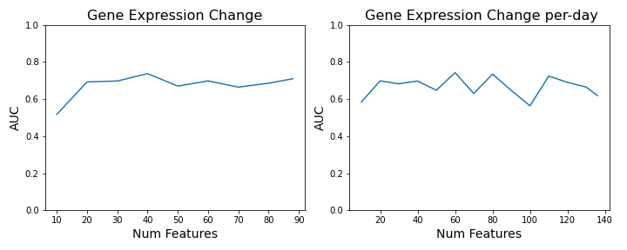
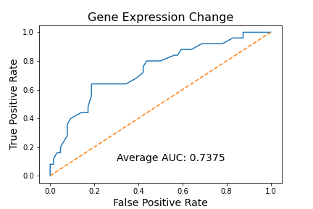
Classification and Results
Random forest classifier with 3-fold cross validation on PNAS dataset
Longitudinal changes in gene expression shows promise for identifying recurrent cancer!

Slide 18
Future Directions
Possible improvements:
Combining/testing different feature selection methods
Trying different model classes (SVM, logistic regression, neural nets) that perform better on sparse data
Further research into transcripts that may be associated with cancer recurrence
This problem is challenging but crucial to improve detection of breast cancer and recurrent breast cancer

Slide 19
Thank You!

